Slide 1

Food Adulteration
Presented by:
Ishan dey (ra2211027010069) Agnideep ghorai(ra2211027010090) Ayush Mukherjee(ra2211027010132)

Slide 2
ABSTRACT
Food adulteration poses a significant threat to public health, making it a critical issue for regulatory bodies and consumers alike. This project focuses on analyzing a dataset related to instances of food adulteration detected during quality inspections. The dataset contains essential information such as the product name, brand, category, adulterant found, detection date, detection method, severity level, health risk, and actions taken. By utilizing this dataset, we aim to identify patterns in food adulteration, assess the effectiveness of quality control processes, and evaluate the potential health risks posed by adulterated food products. The analysis will provide valuable insights for improving food safety standards, strengthening regulatory frameworks, and minimizing the impact of food adulteration on public health. This project also aims to offer recommendations for enhancing inspection methods and ensuring greater consumer protection.

Slide 3
PROBLEM STATEMENT
Food adulteration remains a critical concern, compromising consumer safety and public health. Despite regular quality inspections, instances of adulteration continue to be detected, posing risks to consumers. The challenge lies in identifying patterns of adulteration, assessing the severity of health risks, and improving existing quality control processes. This project seeks to analyze data from food adulteration incidents to uncover trends, evaluate current safety measures, and propose solutions for reducing adulteration and enhancing food safety standards.

Slide 4
EXPLANATION OF FEATURES
This dataset contains simulated data related to instances of food adulteration detected during quality inspections. It includes information such as product name, brand, category, adulterant found, detection date, detection method, severity level, health risk, and actions taken. This dataset can be used for analyzing food safety patterns, improving quality control processes, and assessing the impact of adulteration on public health.
Columns:
adulteration_id: Unique identifier for each instance of adulteration.
product_name: Name of the food product.
brand: Brand name of the product.
category: Category of the food product (e.g., dairy, meat, beverages).
adulterant: Substance found as an adulterant.
detection_date: Date when the adulteration was detected.
detection_method: Method used to detect the adulteration (e.g., chemical analysis, sensory evaluation).

Slide 5
EXPLANATION OF FEATURES
severity: Severity level of the adulteration (e.g., minor, moderate, severe).
health_risk: Health risk associated with the adulterant (e.g., low, medium, high).
action_taken: Action taken after detection (e.g., product recall, warning issued By making use of the above listed features we are able to calculate the food adulterants in the daily food products and make informed decisions by making use of the machine learning models such as Logistic regression, Support Vector machines (SVM) and K Nearest Neighbours (KNN) Model which will be discussed in the above project.

Slide 6
LOGISTIC REGRESSSION
Logistic regression can be applied to this dataset to predict the likelihood of a food product being adulterated based on the various features. The model would classify whether a product is adulterated or not (binary classification) using the following approach:
Target Variable:
Adulterated (Yes/No): The presence of an adulterant in the food product (binary outcome).
Features for Prediction:
Product Name, Brand, Category: These features may capture patterns of adulteration linked to certain types of products or brands.
Detection Date: Could be used to detect temporal patterns or trends in adulteration.
Detection Method: Some methods may detect adulteration more effectively, contributing to better classification.
Severity Level and Health Risk: Indicators that may correlate with adulteration likelihood.
Goal:
To predict whether a product is likely to be adulterated based on these input features.
Benefits:
Helps prioritize high-risk products for quality inspections.
Assists regulators in identifying key factors contributing to food adulteration.
The logistic regression model will output the probability of adulteration, allowing decisions based on a predefined threshold (e.g., 0.5).

Slide 7
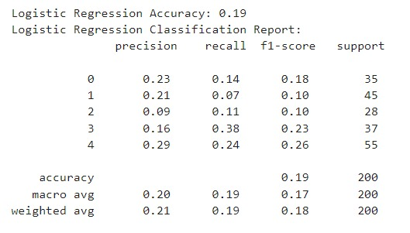
RESULT

Slide 8
KNN MODEL
The K-Nearest Neighbors (KNN) algorithm can be applied to the food adulteration dataset to classify whether a food product is adulterated or not based on its similarity to other products in the dataset. Here's how it works:
Target Variable:
Adulterated (Yes/No): Binary classification of whether a food product is adulterated.
Features for Classification:
Product Name, Brand, Category: These features can be encoded numerically to calculate similarity between products.
Detection Date: Temporal patterns may influence the likelihood of adulteration.
Severity Level and Health Risk: These can help group similar products in terms of safety risks.
Detection Method: Similar methods might yield comparable results for certain types of products.
KNN Approach:
Distance Metric: The algorithm calculates the "distance" between a product and its neighbors based on the selected features.
K Value: Select a value for "K" (number of neighbors) to make predictions based on the majority class (adulterated or not) among the nearest neighbors.

Slide 9
KNN MODEL
Goal:
To classify whether a new or unknown food product is likely to be adulterated based on its similarity to previously inspected products.
Benefits:
Simple, intuitive approach for detecting patterns in adulteration.
No assumptions about data distribution, making it flexible for this type of analysis.
The KNN model will classify products by looking at nearby instances in the dataset, predicting adulteration based on the closest matches.

Slide 10
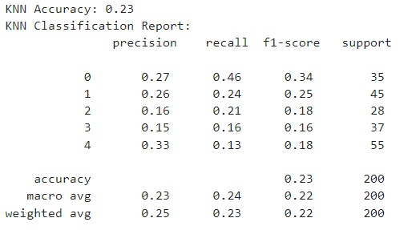
RESULT

Slide 11
RANDOM FOREST CLASSIFICATION
Random Forest is a powerful ensemble learning algorithm that can be applied to the food adulteration dataset to classify whether a food product is adulterated. It builds multiple decision trees and combines their outputs to improve accuracy and robustness. Here's how it works:
Target Variable:
Adulterated (Yes/No): Binary classification indicating if a product is adulterated.
Features for Classification:
Product Name, Brand, Category: Can help identify patterns associated with specific products or brands prone to adulteration.
Detection Date: Time-based trends may emerge that could affect classification.
Adulterant Found: Helps identify common patterns between similar adulterants.
Detection Method: Different methods may have varying success rates in detecting adulteration.
Severity Level and Health Risk: Features that can influence whether a product is likely to be adulterated.
Random Forest Approach:
Multiple Decision Trees: The model constructs many decision trees using random subsets of data and features.
Majority Voting: The final classification is based on the majority vote of the trees.
Feature Importance: Random Forest provides insights into which features are most influential in predicting adulteration.

Slide 12
RANDOM FOREST CLASSIFICATION
Goal:
To predict whether a food product is adulterated based on its features by leveraging the combined predictions of multiple decision trees.
Benefits:
High accuracy and robustness against overfitting.
Handles complex interactions between features effectively.
Identifies important factors contributing to adulteration.
Random Forest provides reliable and interpretable results for food adulteration classification, making it a strong candidate for this problem.

Slide 13
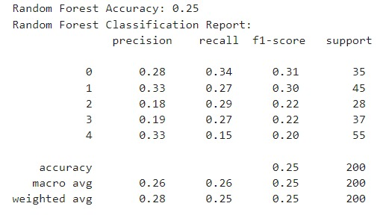
RESULT

Slide 14
SUPPORT VECTOR MACHINES (SVM)
Support Vector Machine (SVM) is a supervised learning algorithm that can be applied to the food adulteration dataset for binary classification, determining whether a food product is adulterated or not. SVM works by finding the optimal hyperplane that separates adulterated and non-adulterated products.
Target Variable:
Adulterated (Yes/No): The binary outcome, indicating if a product is adulterated.
Features for Classification:
Product Name, Brand, Category: These features help distinguish patterns in different types of products.
Detection Date: Temporal trends may assist in detecting recurring adulteration instances.
Adulterant Found: Specific adulterants may be linked to certain types of products or categories.
Severity Level and Health Risk: These can help identify high-risk products for adulteration.
Detection Method: Some methods may better detect adulteration, impacting classification.
SVM Approach:
Hyperplane: SVM finds the hyperplane that best separates adulterated from non-adulterated products in a high-dimensional space.
Kernel Trick: For non-linear relationships, kernel functions (e.g., radial basis function) can be applied to map data into a higher-dimensional space where it becomes linearly separable.
Support Vectors: The model focuses on the data points closest to the hyperplane (support vectors), which influence classification.

Slide 15
SUPPORT VECTOR MACHINES (SVM)
Goal:
To classify food products as adulterated or not by finding the optimal decision boundary that separates the two classes.
Benefits:
Effective in high-dimensional spaces and with complex, non-linear relationships.
Works well for datasets with a clear margin of separation.
Robust to overfitting, especially when using regularization.
SVM is a powerful method for this problem, particularly when there are non-linear relationships between features and adulteration status.

Slide 16
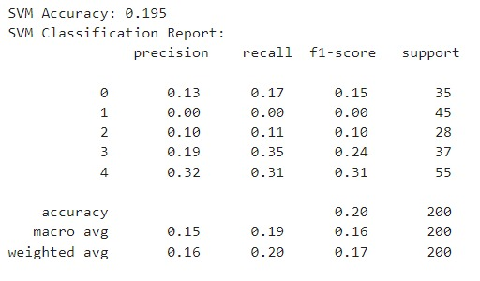
RESULT

Slide 17
COMPARISON
Upon analysing all three models for finding out the the most accurate ot of all the four models i.e : 1. Logistic Regression 2. K nearest Neighbours 3. Random Forest Classification 4. Support Vector Machines We found out that the Random Forest Classification was the highest in terms of accuracy (25%) as compared to all the others. Thus we will chose Random Forest Classification for our project on food Adulteration Analysis. The detailed comparison of all the four models is shown in the next slide below.

Slide 18
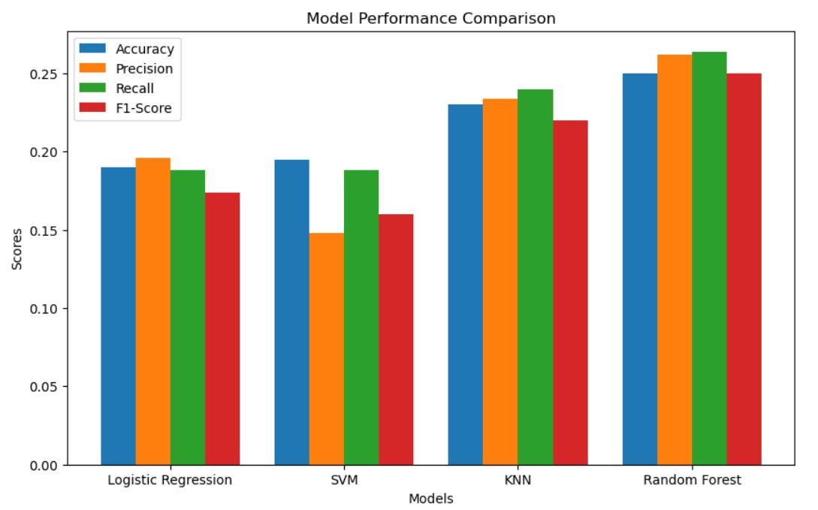
FINAL RESULT

